Slide 1
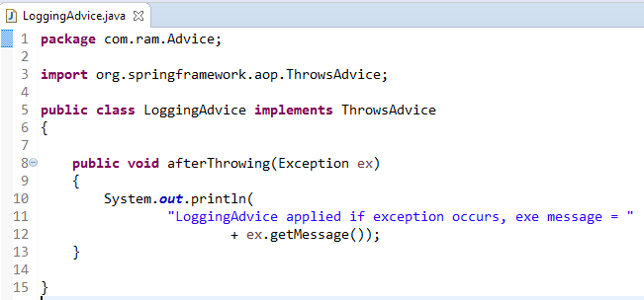
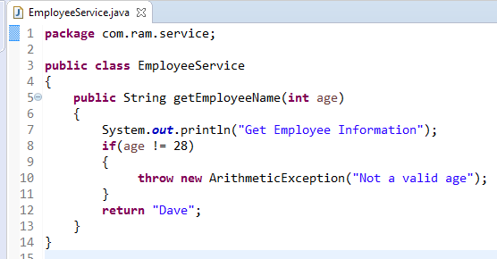
ThrowsAdvice Example
method
Throws Advice is executed if actual method throws an exception.
Throws Advice
2
1
If exception occurs

Slide 2
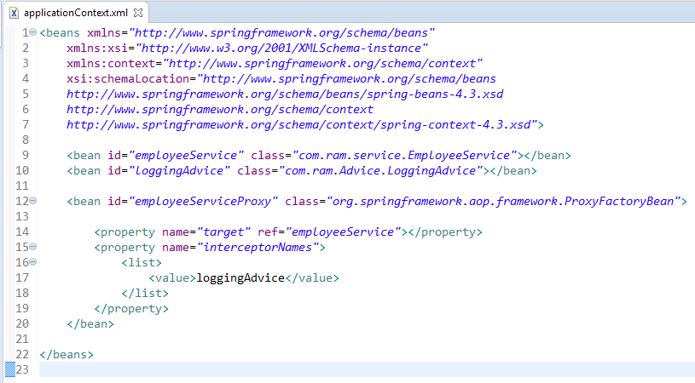
ThrowsAdvice Example
In xml file, create 3 beans, one for EmployeeService class, second for loggingAdvice class and third for ProxyFactoryBean class.
The ProxyFactoryBean class is provided by Spring Famework. It contains 2 properties target and interceptorNames. The instance of EmployeeService class will be considered as target object and the instance of loggingAdvice class as interceptor.

Slide 3
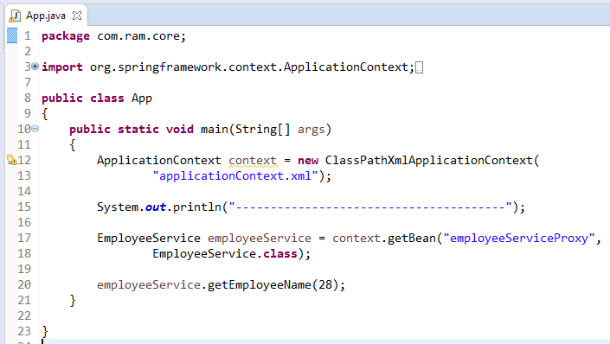
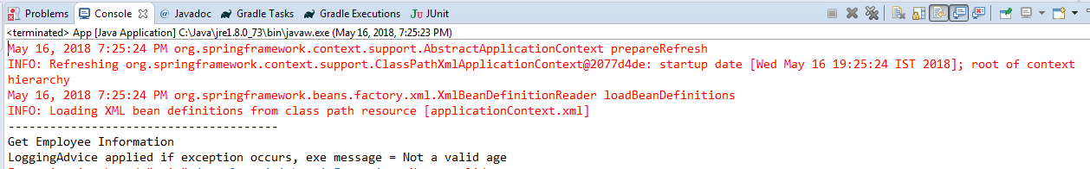
ThrowsAdvice Example

